Slide 1
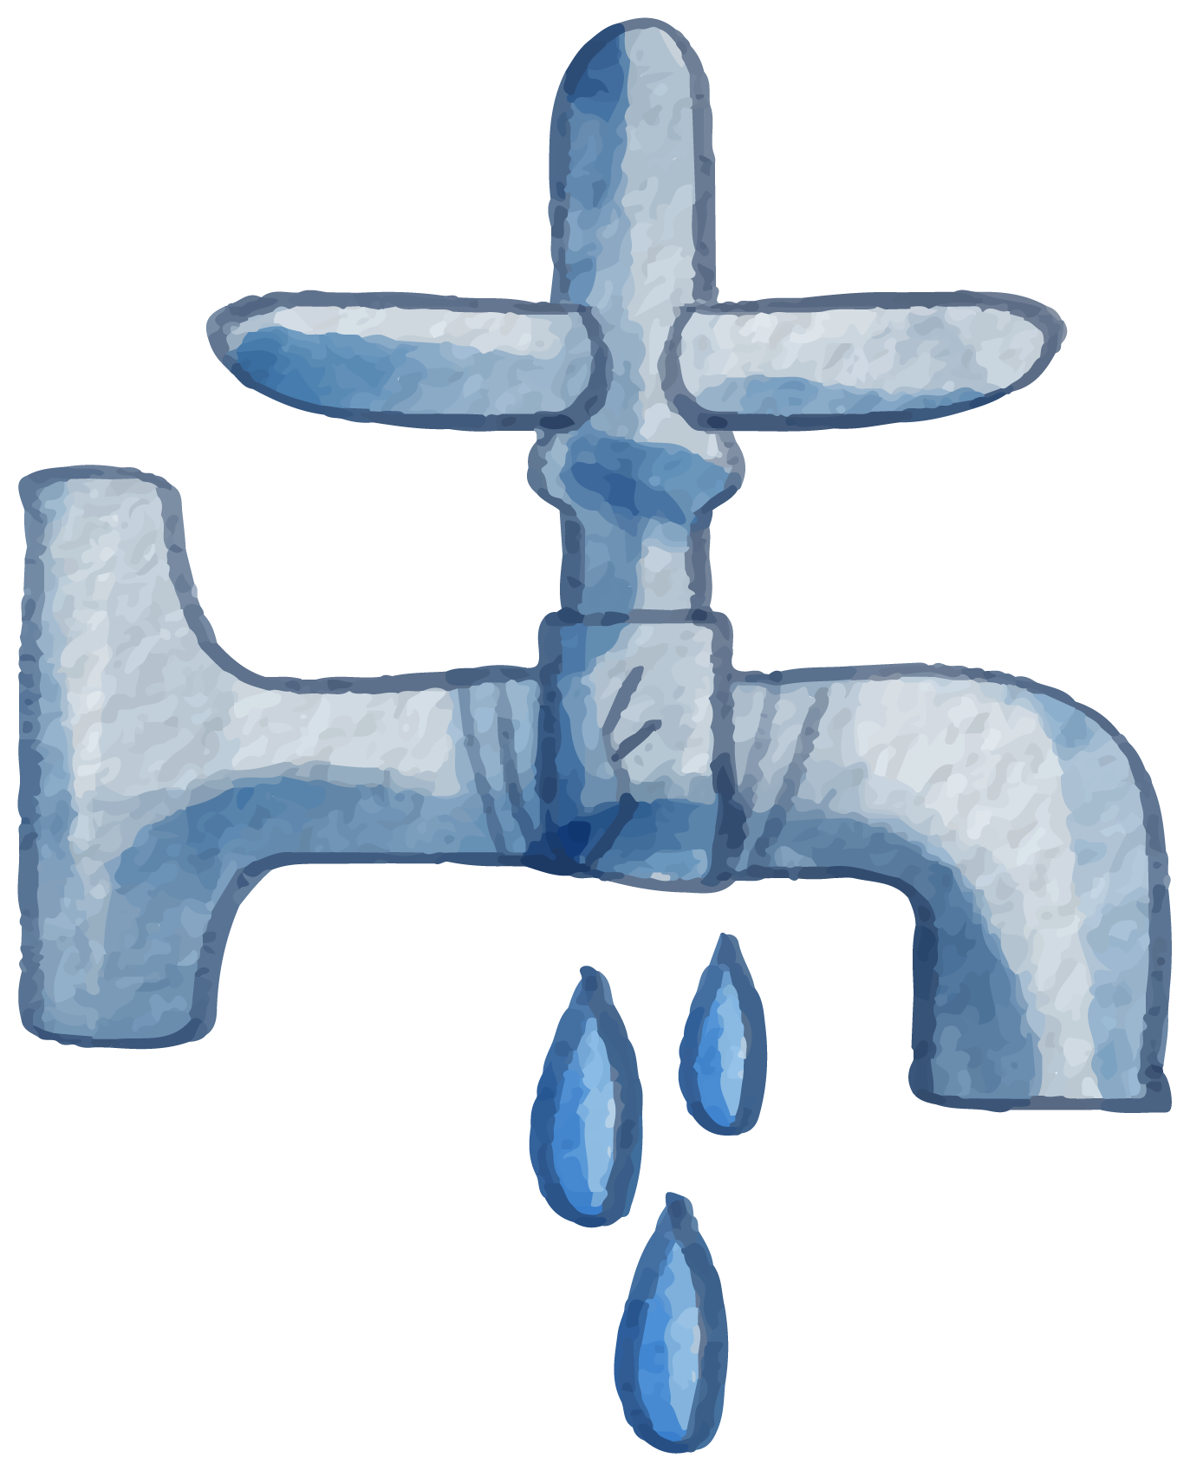
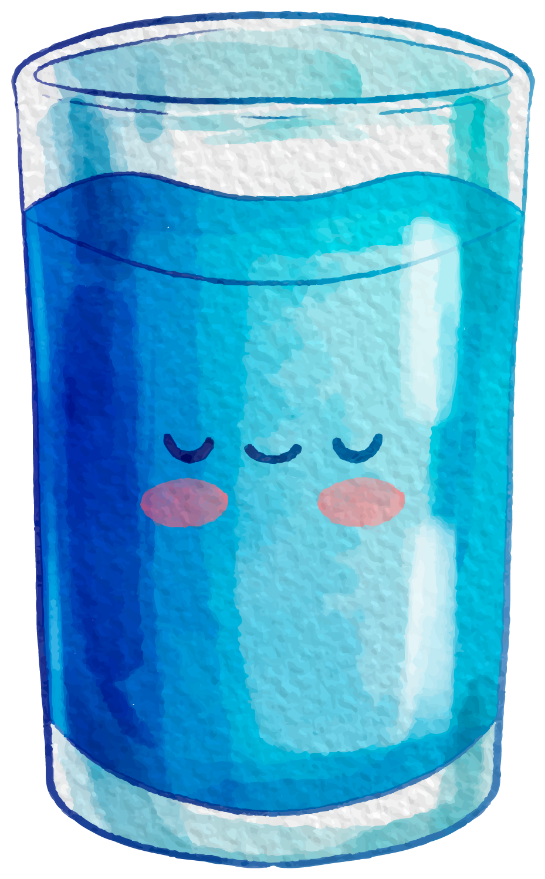
Campaign for Water Use Water Usage
"نقطة مياه تساوي حياة! "
“Don’t Let the Water Flow, Let the Awareness Grow! ”

Slide 2
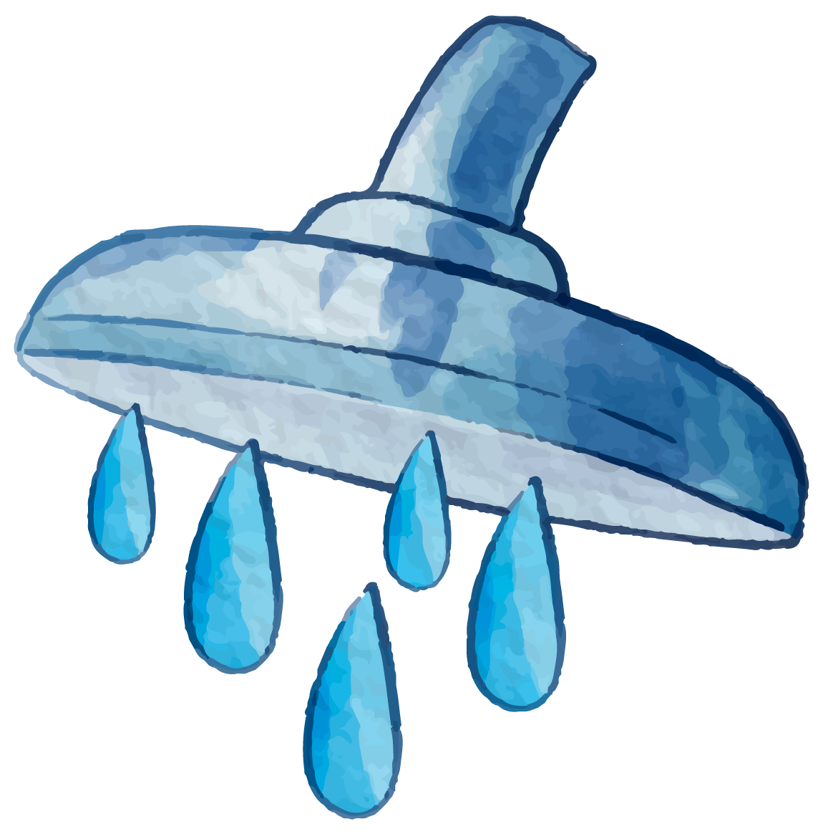
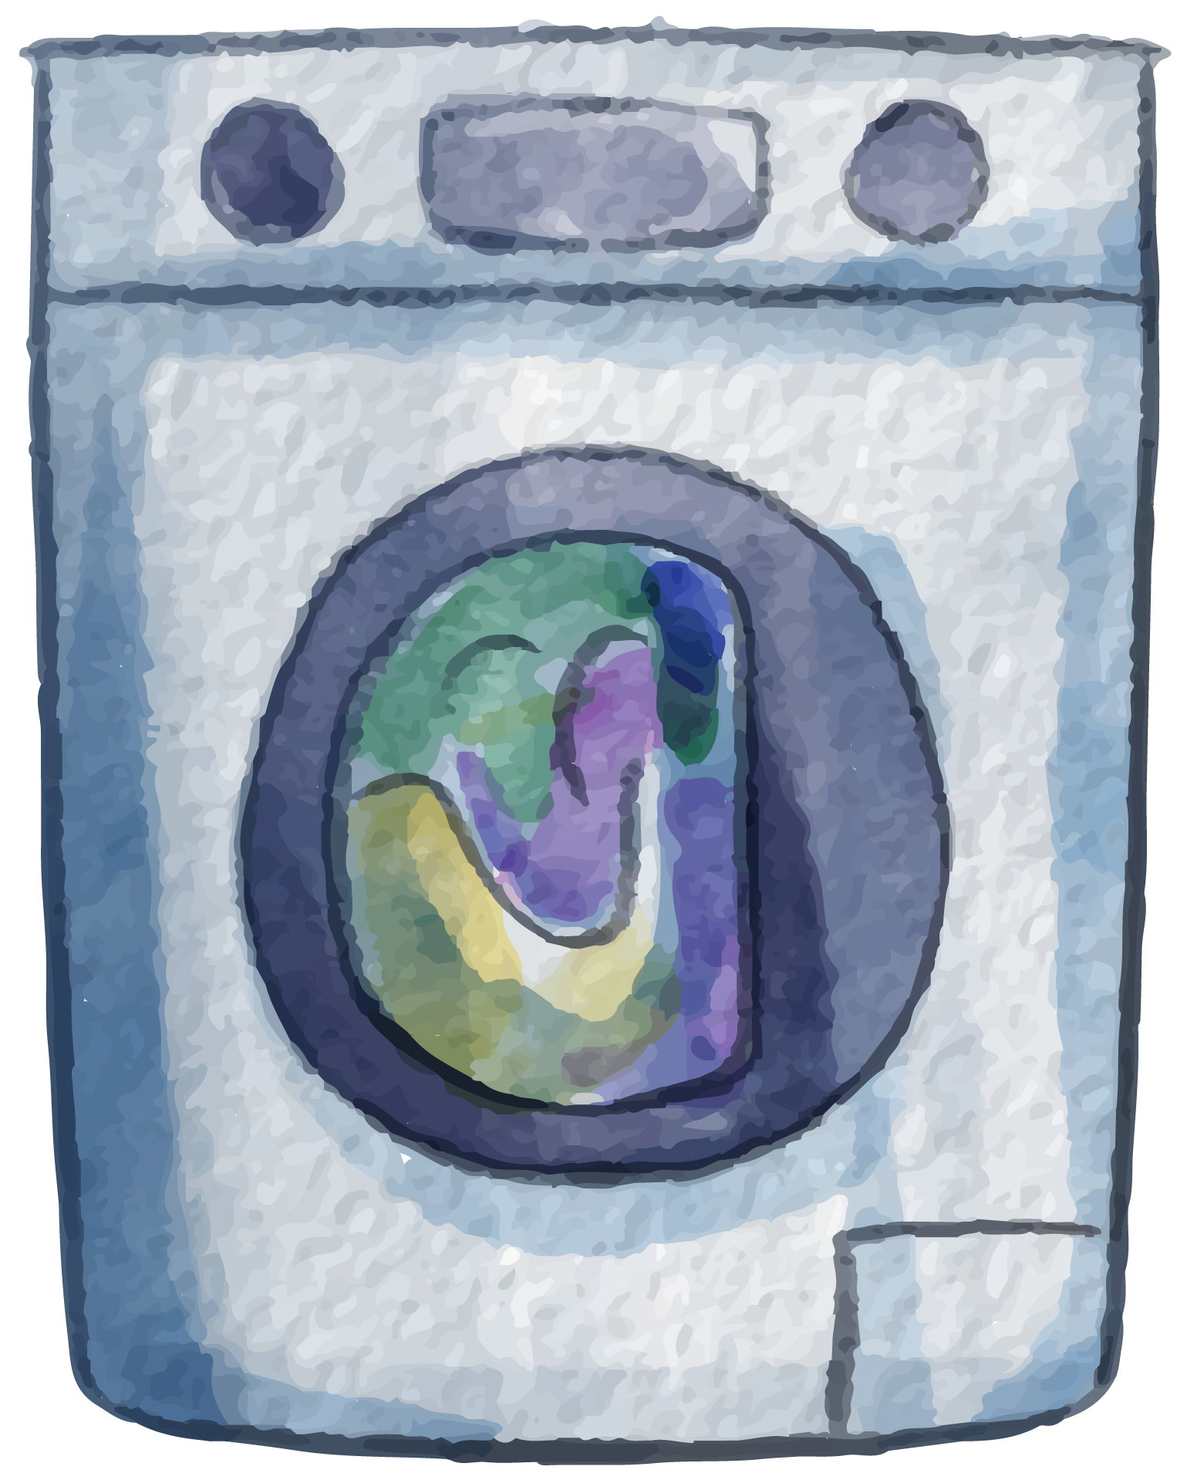
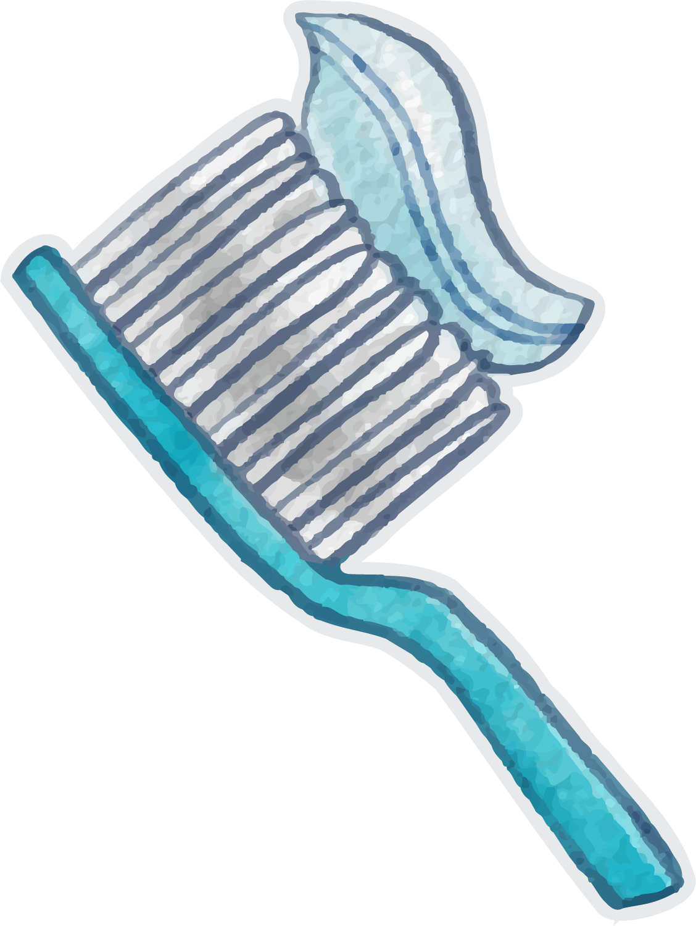
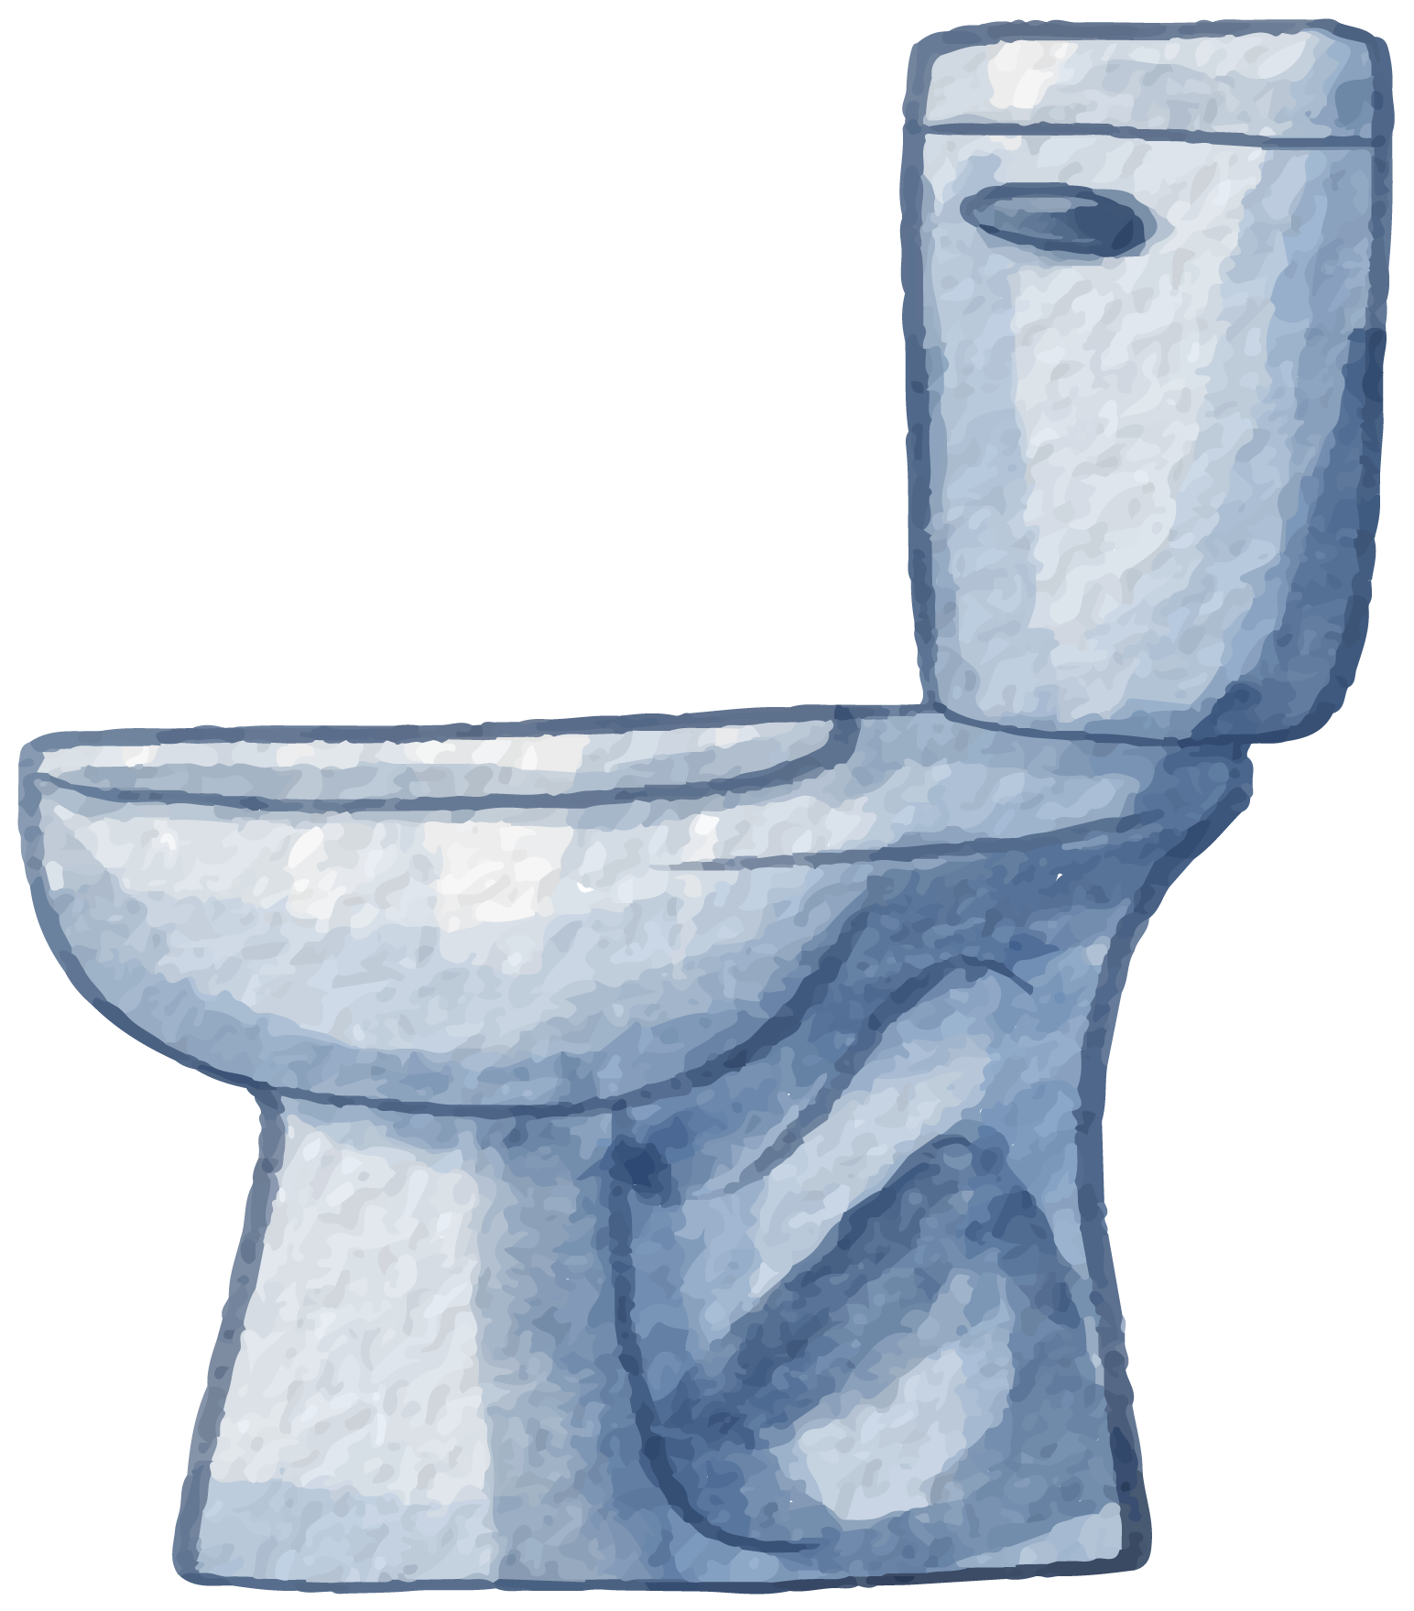
Water Usage at Home:
SHOWER
WASHER
Showers use about 46% of household water. Shortening your shower time saves both water and energy.
Showers use about 17% of household water. Shortening your shower time saves both water and energy.
46%
17%
TEETH BRUSHING
TOILET
Brushing your teeth with the tap on wastes water — turn it off to save up to 24%.
Toilets account for about 27% of indoor water use. Use low-flow toilets or place a water-saving device in the tank.
24%
27%

Slide 3

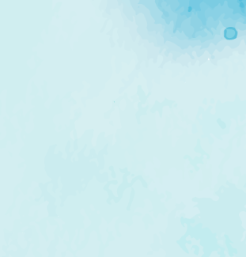
Water Usage:
Domestic (Drinking, showers, cooking)
Sanitation (Toilets, hygiene)
15%
10%
Agriculture (Crops)
Agriculture (Livestock, irrigation loss)
25%
25%
Leaks, waste & unaccounted loss
Industry (Manufacturing, cooling, energy)
5%
20%

Slide 4

Benefits of Water:
We need water every day in our life and there are many benefits of water
BENEFIT 01 :
BENEFIT 03
Conserves Natural Resources By saving water, we help protect freshwater ecosystems, lakes, rivers, and wetlands.
Protects Aquatic Habitats: Less water usage means more water remains in rivers, lakes, and wetlands, supporting diverse wildlife and aquatic ecosystems.
BENEFIT 02
BENEFIT 04
Less Energy for Water Treatment: Water treatment facilities use a significant amount of energy. By using less water, we reduce the energy demand for pumping
Improved Public Health: Reduced water waste means cleaner and more reliable water sources for communities, promoting better sanitation and overall health.

Slide 5
Water Problems and Solutions:
PROBLEMS
1
2
3
Wasting Water in farming.
Water waste from tape.
Garbage thrown in water.
SOLUTIONS
1
2
3
Use of Soil Moisture Sensors
Be sure to Close the Tap when you Finish
Use the bins! Don't dump rubbish in the water.

Slide 6
Don’t and Do
Don’t throw garbage into water bodies
Always throw trash in bins, not in rivers, lakes, or drains.
Dispose of waste properly
Plastic, food, and waste pollute and harm aquatic life.
Don’t wash vehicles near rivers or lakes
Alert local authorities if you see oil spills, illegal dumping, or pipe leaks.
Report leaks and pollution
Soap, oil, and dirt can run into natural water sources.
Don’t dump industrial or construction waste illegally
Use natural fertilizers and pesticides wisely
Always follow proper disposal guidelines.
Reduces runoff into nearby water bodies.

Slide 7
ACTION 02
ACTION 04
Fix leaks promptly
Collect rainwater
ACTION 01
ACTION 03
ACTION 05
Turn off the faucet while washing
Use water-saving appliances
Water your plants at the right time

Slide 8
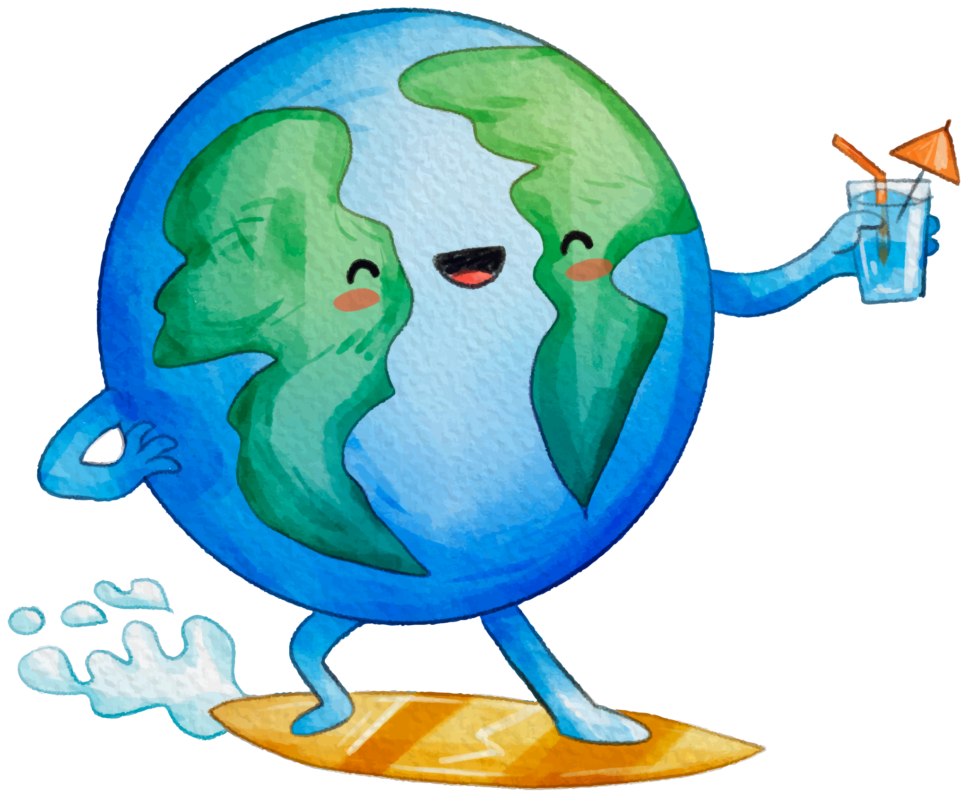
Save Water
WHAT CAN WE DO
Saving Water is very Important as It is the reason Of Living
1
Turn off taps when not in use
2
Reuse clean water when possible
3
Use only the water you need

Slide 9
Made By :
Mohamed abdelhalim
(Presentation,Arabic Translation, Video Maker/Editor)
Geovany Melad Gerges
(Team Leader, Presentation)
Ahmad Tamer
(Encouraging, If anyone wants me, call me)
Abdelrahman Mohamed
(Front/Back End Developer, Graphic Design)

